Slide 1
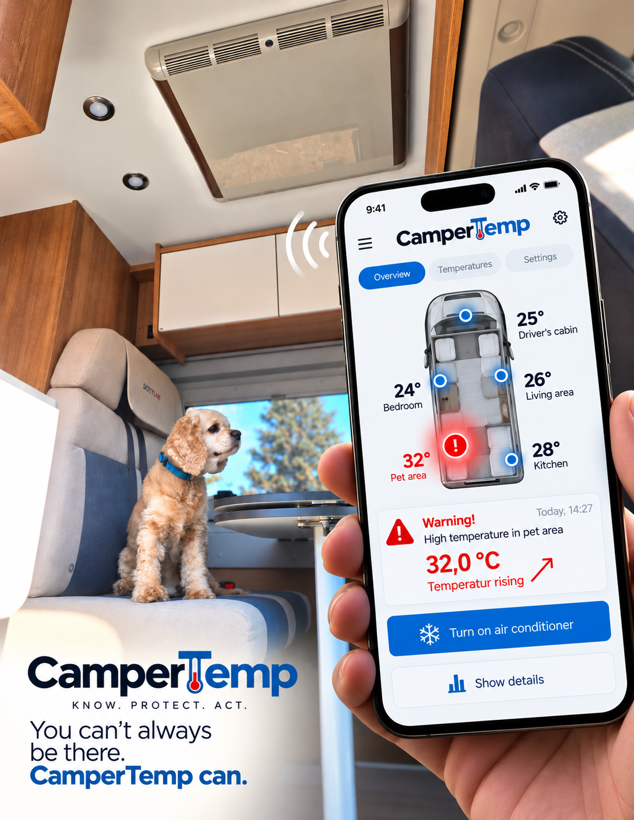
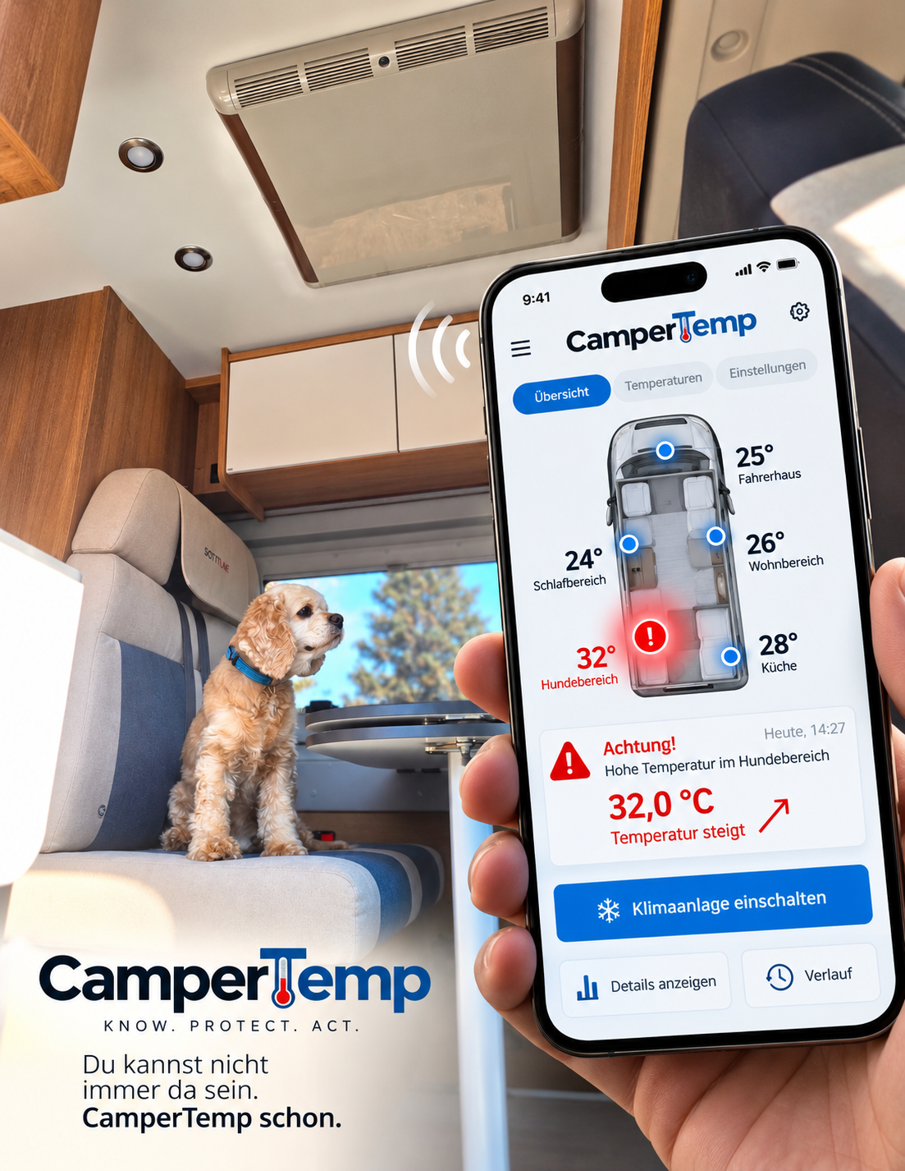
CAMPERTEMP
One Camper.
Many Temperatures.
An Invisible Risk.
A single temperature reading does not show
what is happening in other areas of the vehicle.
RELEVANT PROTECTION AREAS
🐕
Dog
🛏
Sleeping
🏠
Living
💊
Medications
CamperTemp monitors multiple areas,
detects temperature development and enables
predictive action.
Don't just measure what is. Recognize what is happening.

Slide 2
THE INNOVATION
From Temperature Monitoring to Predictive Temperature Safety
CamperTemp does not just look at a single reading – it tracks the development across multiple relevant interior areas.
01
02
03
04
DETECT
→
RECOGNIZE
→
PREDICT
→
ACT
Multiple relevant
interior areas
Temperature development
instead of just the current value
Critical development
before the threshold
Warn and/or
take countermeasures
WHERE IS THIS RELEVANT?
🐕
Dog
👨‍👩‍👧
Children
🛏
Sleeping
🏠
Living
💊
Medication
Don't just measure what is. Recognize what is happening.
CamperTemp · Predictive Temperature Safety
02

Slide 3
TECHNOLOGY & PROTECTION
A Protected Technology Architecture
The strength lies in the combination of multiple technical building blocks – not in a single sensor.
01
Spatially distributed
temperature monitoring
02
Predictive assessment
of temperature development
03
Individual
monitoring zones
04
Freely positionable
sensors
05
Warnings &
countermeasures
06
Cross-manufacturer
integration / retrofit
Not just a sensor product – a technology architecture for climate, energy and smart-camper systems.
PATENT FILED · 22.09.2026
CamperTemp · Predictive Temperature Safety
03

Slide 4
SCALABILITY
One Technology. Many Applications.
CamperTemp can start as a standalone product and integrate into existing ecosystems.
TODAY
Retrofit / Aftermarket
Scalable Business Models
TOMORROW
Smart-Camper Systems
⚙
Hardware
☁
Software & Services
EXPANSION
Climate & Energy
↔
Integration
▣
Licensing
INDUSTRY
Manufacturer Integration / OEM
◆
IP / Technology
One product today. An integration platform tomorrow.
CamperTemp · Predictive Temperature Safety
04

Slide 5
USERS & MARKET
A Large User Base. A Growing Vehicle Fleet.
CamperTemp addresses a real-world use case – with measurable reach in Germany and Europe.
👥
🚐
🐕
⛺
17 Mio.
> 1,8 Mio.
46 %
413 Mio.
People with a connection to camping
in Germany
Caravans & motorhomes
in Germany
of surveyed German
motorhome users traveling with a pet
Camping/RV/trailer
overnight stays in the EU
25% of the population aged 16+
registered vehicle stock
96% of them own dogs
2025 · +28.5% since 2015
2025
94.134
new leisure vehicles
in Germany
>215.000
new registrations
in Europe
→ real, growing
use situations
CamperTemp – Predictive Temperature Safety for mobile interiors.
Sources: ADAC · CIVD · CamperContact · Eurostat
CamperTemp · Predictive Temperature Safety
05

